Slide 1

Unsupervised machine learning
SeiedeShiva Moosavi

Slide 2
Agenda
Introduction
Data cleaning
Features
Data exploration
Feature Engineering
Machine learning Models
Comparisons
Conclusions
Reference

Slide 3
Introduction
In the research, a cluster analysis is performed for bank customers
The customers were clustered by attributes including age, sex, credit limit and other additional features
Hierarchical clustering is used.

Slide 4

Data cleaning
Some of Unknown data dropped

Slide 5
Features
There are 23 features in the data including: Client Number, Age, Gender, Marital Status, Education Level, Income Category, Card Category, Months on the Bank Credit Limits, Total Revolving Balance, Number of Transactions, Average Utilization Ratio.

Slide 6
Data exploration
Card_Category | Blue | Gold | Platinum | Silver
Income_Category
$120K + | 0.076868 | 0.168224 | 0.266667 | 0.119522
40𝐾−40K−60K | 0.199619 | 0.140187 | 0.066667 | 0.197211
60𝐾−60K−80K | 0.151710 | 0.271028 | 0.266667 | 0.191235
80𝐾−80K−120K | 0.166250 | 0.196262 | 0.133333 | 0.233068
Less than $40K | 0.405554 | 0.224299 | 0.266667 | 0.258964

Slide 7
Data exploration
Card_Category | Blue | Gold | Platinum | Silver
Education_Level
College | 0.924862 | 0.015470 | 0.000000 | 0.059669
Doctorate | 0.937008 | 0.013123 | 0.005249 | 0.044619
Graduate | 0.926323 | 0.011803 | 0.001788 | 0.060086
High School | 0.937360 | 0.012864 | 0.000559 | 0.049217
Post-Graduate | 0.921109 | 0.008529 | 0.004264 | 0.066098
Uneducated | 0.932412 | 0.008449 | 0.001536 | 0.057604
Unknown | 0.935226 | 0.012373 | 0.002183 | 0.050218

Slide 8

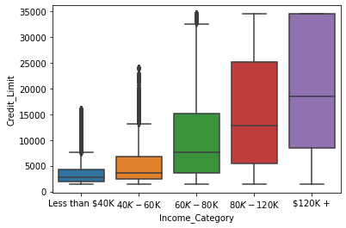
Data exploration

Slide 9
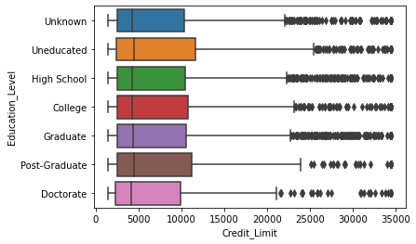
Data exploration

Slide 10
Feature Engineering
The following features has been selected:
"Customer Age", "Gender", "Education Level", "Marital Status",
"Income Category", "Card Category", "Months on book",
"Months_Inactive_12_mon", "Contacts_Count_12_mon",
"Credit Limit", "Total_Revolving_Bal", "Avg Open To Buy",
"Total_Amt_Chng_Q4_Q1", "Total Trans Amt",
“Total Trans Ct", "Total_Ct_Chng_Q4_Q1",
"Avg Utilization Ratio"

Slide 11
Feature Engineering
The Categorical data converted to numeric by using dummy
The numeric data scaled by using StandardScaler

Slide 12
Machine learning Models
Agglomerative Clustering
DBSCAN

Slide 13

Agglomerative Clustering

Slide 14
Distance Metrics
Gower

Slide 15
Silhouette Score
n_clusters=2 -> silhoette_score is 0.266
n_clusters=3 -> silhoette_score is 0.251
n_clusters=4 -> silhoette_score is 0.148
Based on further analysis of the groups, for this research, I choose number of clusters to be three.

Slide 16
Clusters
The least
Credit Limit; Avg Open To Buy; Total Trans Amt; Marital Status Divorced or Single;
The most
Customer Age; Months on book; Months_Inactive_12_mon; Total_Ct_Chng_Q4_Q1;Avg_Utilization_Ratio; Gender F; Education Level Graduate or High School; Marital Status Married; Income Category Less than $40K; Card Category Blue
The least
Total Trans Ct; Education Level Graduate
The most
Contacts_Count_12_mon; Total Revolving Bal ; Total_Amt_Chng_Q4_Q1; All men; Education Level College or Postgraduate or Uneducated; Income_Category_$120K + or 60𝐾− 80K or 80𝐾− 120K; Card Category Platinum.
The least
The least: customer age; Months on book; Months_Inactive_12_mon; Contacts_Count_12_mon; Total Revolving Bal; Total_Amt_Chng_Q4_Q1; Avg Utilization Ratio; Education Level High School or Post-Graduate or Uneducated; Marital Status Married;
The most
The most: Credit Limit; Avg Open To Buy; Total Trans Amt; Total Trans Ct; Education Level Doctorate; Marital Status Divorced or Single; Income Category_ 40𝐾− 60K; Card Category Gold or Silver
Cluster 0 : Married Low-income Women with the least Credit Limit
Cluster 1 : Men with Middle to High income and the most Revolving Balance.
Cluster 2 : Unmarried youngest and the most educated level with the most Credit Limit

Slide 17
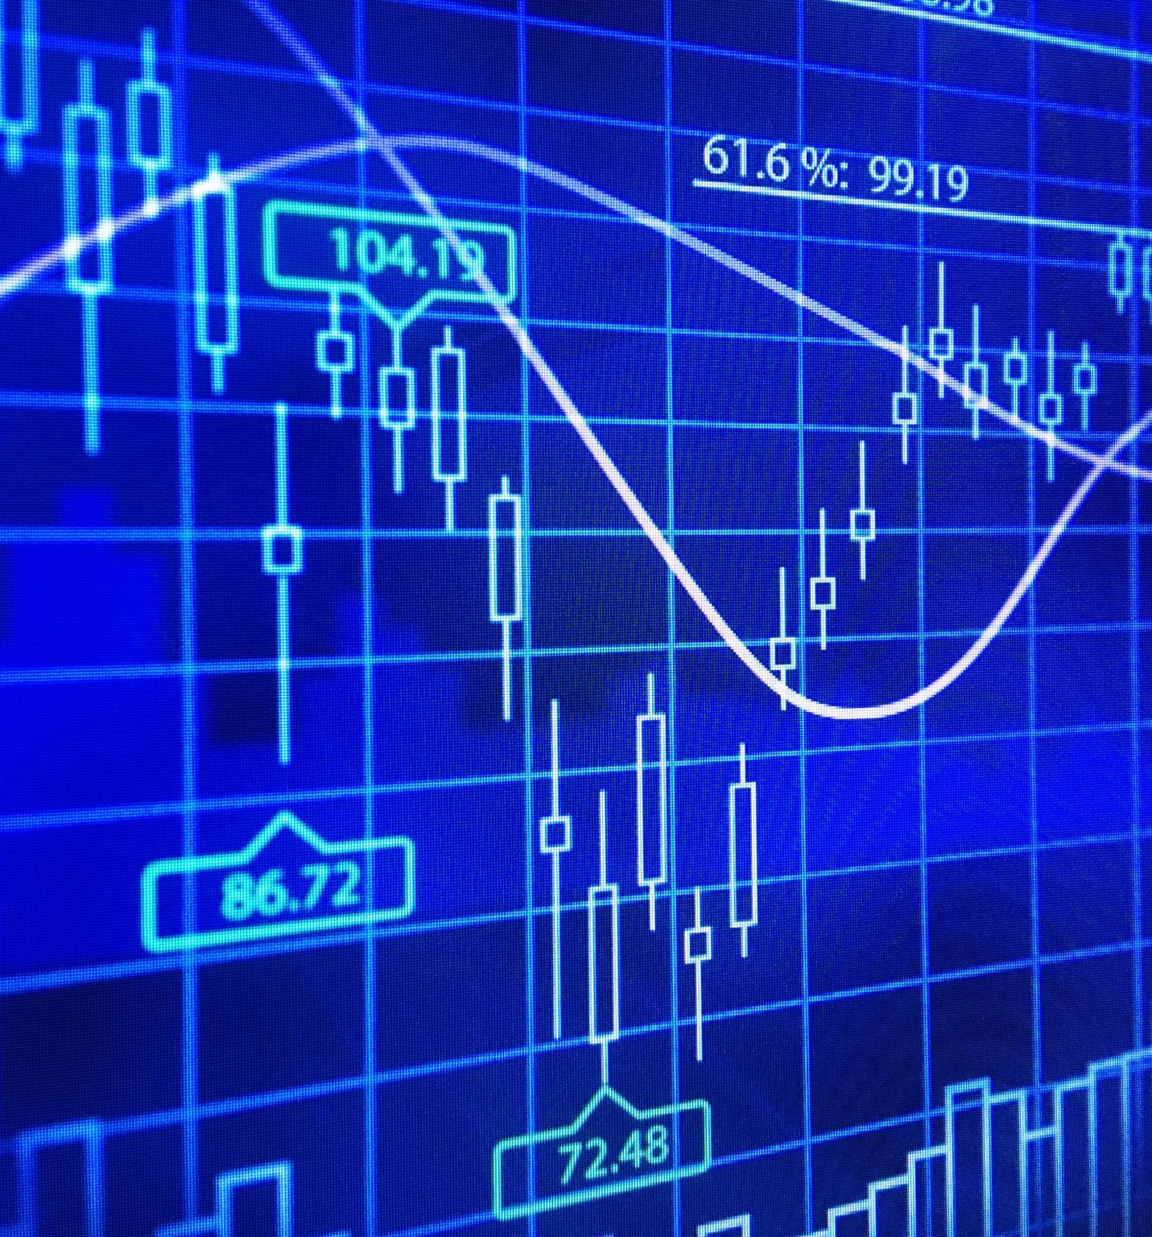
Comparisons
Also, Dbscan is used. It is not a good cluster here because, it considers more data as outliers. Esp and cluster numbers are changed but does not work.

Slide 18
Conclusions
The research is about unsupervised machine learning which creates four clusters based on some common features. The results can be used by bankers.

Slide 19

Reference
Credit Card customers | Kaggle

